Slide 1
Product and Category Analysis for Retail Data

Slide 2
Problem Statement
Analyze the product data to provide insights into product pricing, reviews, and stock management to improve business operations and customer satisfaction.
Provide insights on product pricing, reviews, supplier details, and return policies.
Combine SQL queries and Power BI visuals to deliver actionable insights.

Slide 3
Dataset
Data_retail.csv

Slide 4
SQL-Based Analysis
Identified products with prices higher than the category average.
Found categories with the highest average rating.
Found the most reviewed product in each warehouse.
Identified high-priced products along with discount & supplier.
Identified top 2 products with highest rating in each category.
Analyzed Return Policies.

Slide 5
Power BI Visualizations
Insights derived using Power BI dashboard built from the retail dataset with DAX calculations, measures, and interactive visuals.
Product category generating highest revenue compared to stock availability.
Correlation between product price and rating.
Warehouse with most products having the longest return policy.
Review counts vs rating correlation.
Warehouse turnover impact on stock management & profit margin.

Slide 6
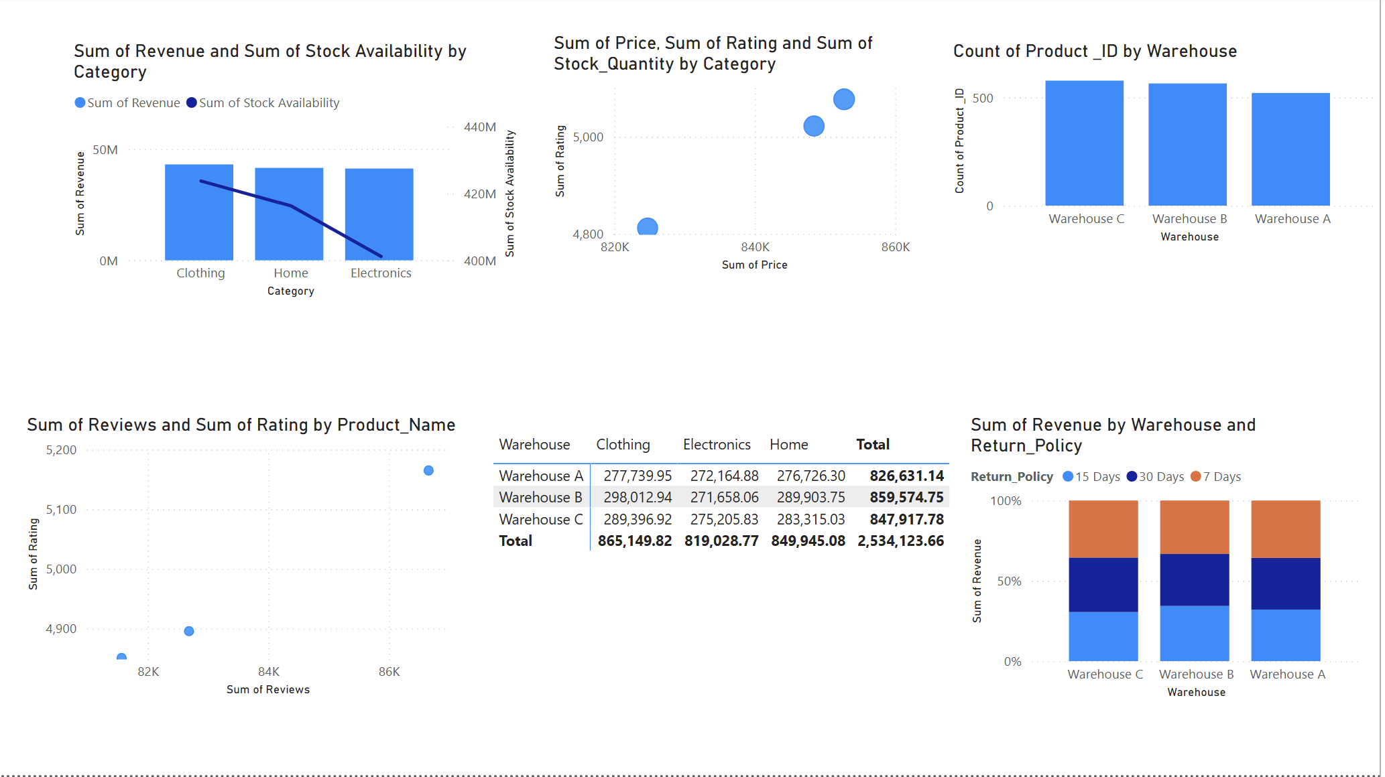
Power BI Dashboard

Slide 7
Recommendations
Key Insights
High-priced items are concentrated in certain categories.
Some categories with high average ratings have low stock.
Longer return policies boost sales in certain categories.
Strong correlation between competitive pricing and higher ratings.
Revising pricing in overpriced categories to boost competitiveness.
Stocking up in categories with high ratings but low availability.
Promoting longer return policies as a sales strategy.

Slide 8
Conclusion
Data-driven strategies improve revenue and customer satisfaction.
SQL based analysis helped extract precise product-level insights.
Power BI visualizations revealed trends and correlations.
Recommendations can guide pricing, inventory, and marketing decisions.

